Slide 1

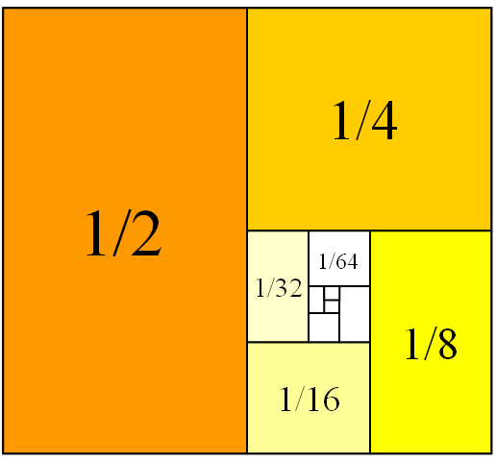
Mathematics for Engineering: Calculus
Chapter 5: Sequences and Series
(Dãy số và chuỗi số)
Department of Mathematics, FPT University

Slide 2
Mathematics for Engineering: Calculus
Topics:
  5.1 Sequences
  5.2 Infinite Series
  5.3 The Divergence and Integral Tests
  5.4 Comparision Tests
  5.5 Alternating Series
  5.6 Ratio and Root Tests

Slide 3
5.1 Sequences
Definition
A sequence is a list of numbers written in definite order:
a₁, a₂,…,a_{n} ,…
a₁ is first term, a₂ is second term,…, a_{n} is the nth term.
Notation: The sequences {a₁, a₂,…,a_{n},…} is also denoted by {a_{n}}.

Slide 4
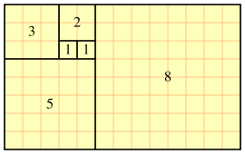

5.1 Sequences
Example
Find the first 6 terms of Fibonacci sequence {f_{n}}
1, 1, 2, 3, 5, 8, …

Slide 5
5.1 Sequences
Example
Find a formula for the general term a_{n} of the sequence:
{3/4, -4/8, 5/16, -6/32, 7/64,…}
Solution:
a_{n} = (-1)^{n-1}(n+2)/2^{n+1}

Slide 6
5.1 Sequences
Definition
The sequence {a_{n}} has the limit L, written
lim_{n→∞}a_{n}=L,
if we can make the terms a_{n} as close to L as we like by taking n sufficiently large.
If limit L exists and is finite, we say {a_{n}} converges; otherwise, it diverges.

Slide 7
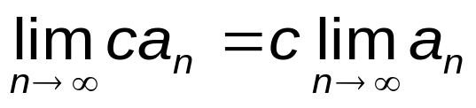
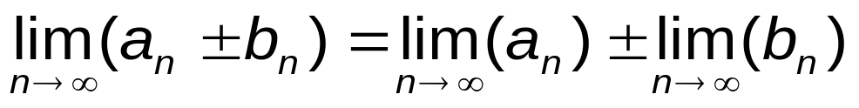
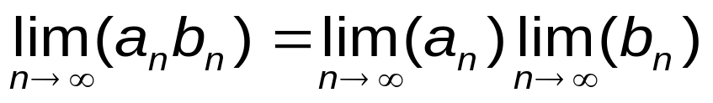
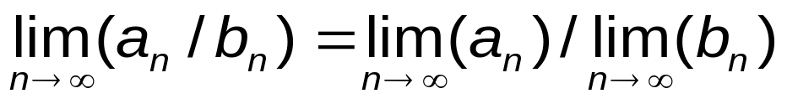
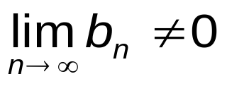
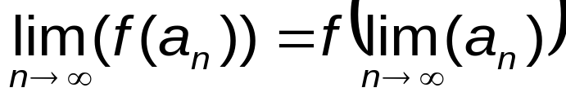
5.1 Sequences
Theorem
provided
provided that f is continuous
Theorem
Suppose that f :R→R such that lim_{x→∞}f(x) = L. Then the sequence {a_{n} = f(n)} also converges to L.

Slide 8
5.1 Sequences
Example
Investigate the convergence of the sequences:
a_{n} = (-1)^{n}
a_{n} = (ln n)/n
a_{n} = n!/n^{n}

Slide 9
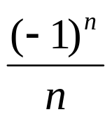
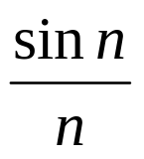
5.1 Sequences
Theorem
If lim_{x→∞} |a_{n}|=0 then lim_{x→∞} a_{n}=0
Example
Investigate the convergence of the sequences:
(a)
(b)

Slide 10
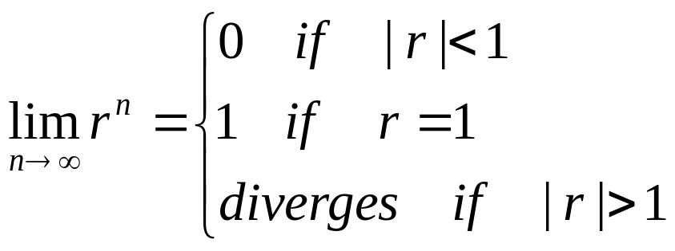
5.1 Sequences
Theorem

Slide 11
5.1 Sequences
Definition
A sequence {a_{n}} is called increasing if a_{n} < a_{n+1} for all n.
A sequence {a_{n}} is called a decreasing if a_{n} > a_{n+1} for all n.
A sequence is called a monotonic if it is either increasing or deceasing.
Definition
A sequence {a_{n}} is bounded above if there exists a number M such that a_{n} ≤ M for all n.
A sequence {a_{n}} is bounded below if there exists a number m such that a_{n} ≥ m for all n.
A sequence is bounded if it is both bounded above and below.

Slide 12
5.1 Sequences
Theorem
Every sequence that is both increasing and bounded above is convergent.
Every sequence that is both decreasing and bounded below is convergent.
Every bounded monotonic sequence is convergent.

Slide 13
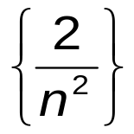
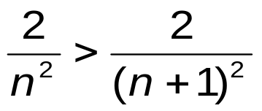
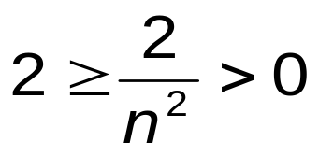
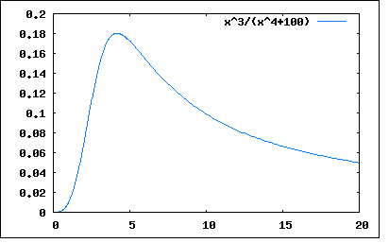
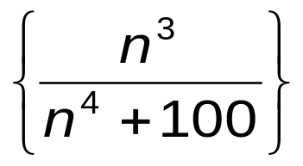
5.1 Sequences
Example
Which sequences are monotonic? bounded? convergent?
→ decreasing;
→ bounded
→ convergent
put f(x)=x³/(x⁴+100)
f ’(x) = −x²(x⁴−300)/(x⁴+100)
→ f ’(x) < 0 when x ≥ 5
decreasing from n=5 and bounded from below
→ convergent

Slide 14
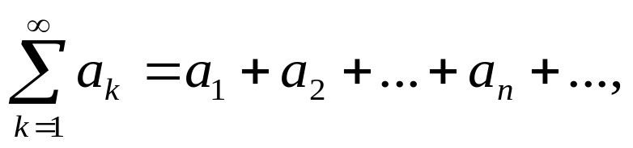
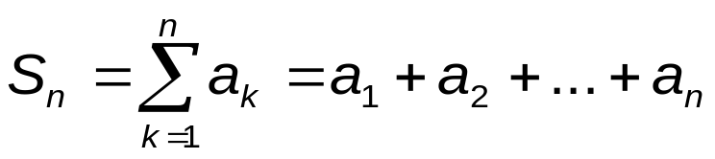
5.2 Infinite Series
Definition
The sum (infinite) of terms of a sequence {a_{n}}, denoted by
is called a series.
The sum of first n terms:
is called the n^{th} partial sum.
If the sequence {S_{n}} is convergent, then series is called convergent. Otherwise, the series is called divergent.

Slide 15
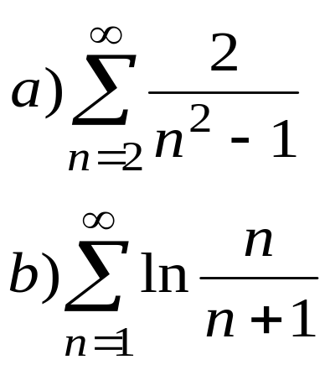
5.2 Infinite Series
Example
Find the nth partial sum of the following series and determine whether the series is convergent or divergent.

Slide 16
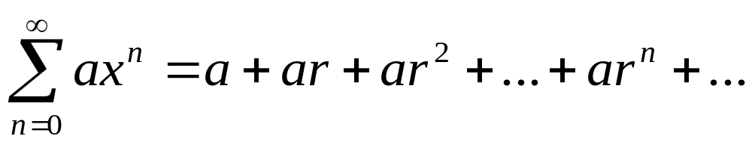
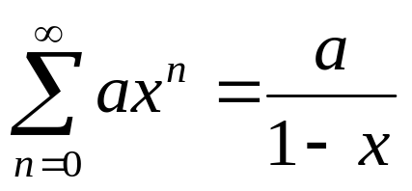
5.2 Infinite Series
Definition
A geometric series is a series of the form
Theorem
If |x|<1 then
else the series is divergent.

Slide 17
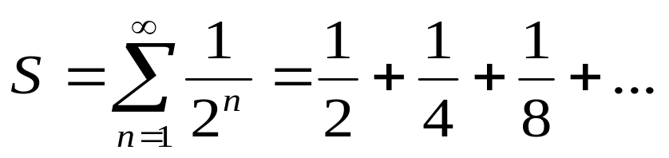
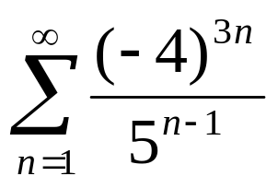
5.2 Infinite Series
Example
Which of the following series is convergent?
(a)
(b)

Slide 18
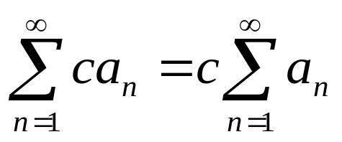
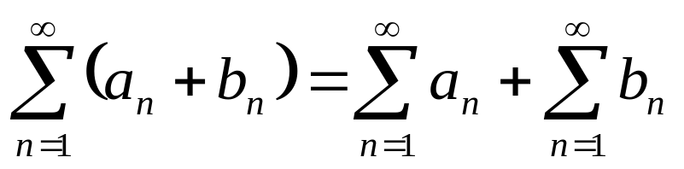
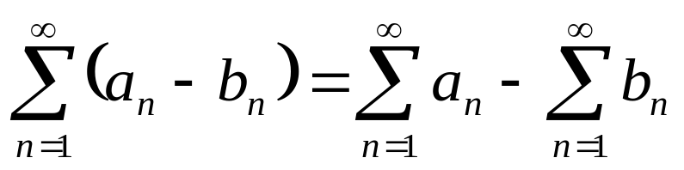
5.2 Infinite Series
Theorem
If Σ a_{n} and Σ b_{n} are convergent series, then so are the following series

Slide 19
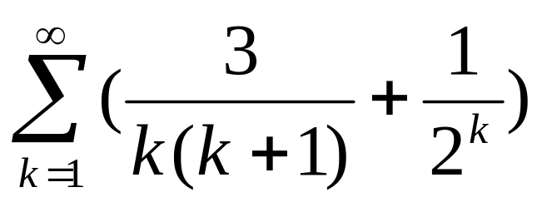
5.2 Infinite Series
Example
Find the sum of the series

Slide 20
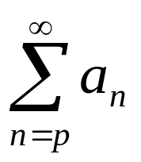
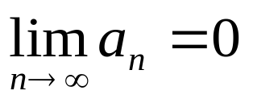

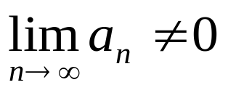
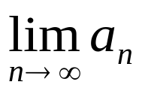
5.3 The Divergence and Integral Tests
Theorem
(a) If the series is convergent, then
(Test for divergence)
If or does not exist, then the
series is divergent.

Slide 21
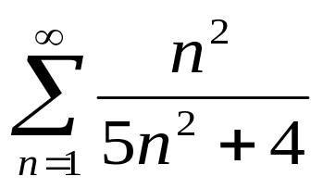
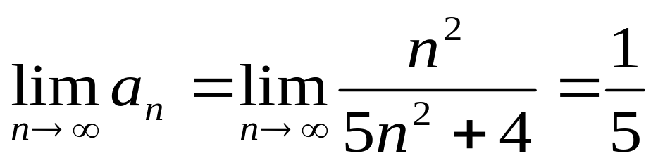
5.3 The Divergence and Integral Tests
Example
Show that the series diverges
Solution
→ series is divergent.

Slide 22
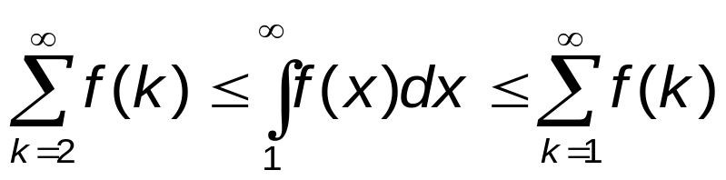
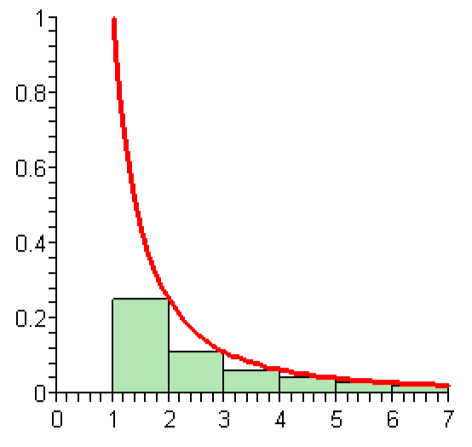
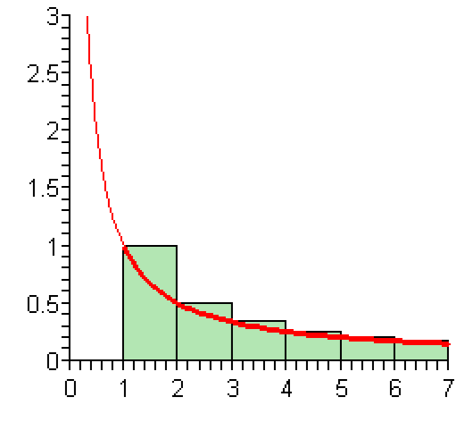
5.3 The Divergence and Integral Tests
Theorem
Suppose that f :R→R is a continuous, positive, decreasing function. Then,

Slide 23
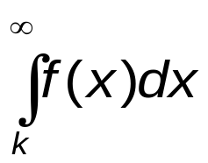
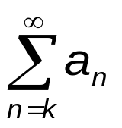
5.3 The Divergence and Integral Tests
The Integral Test
Suppose that f(x) is a continuous, positive, decreasing on
[k, ∞) and let f(n)=a_{n} . Then:
If converges, then also converges.
If diverges, then also diverges.

Slide 24
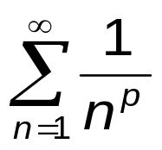
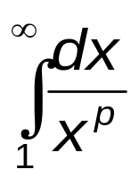
5.3 The Divergence and Integral Tests
Example
Determine whether the p-series
converges or diverges.
Solution: We know
converges if p >1 and diverges if p ≤ 1.
Then converges if p >1 and diverges if p ≤ 1.

Slide 25
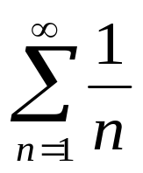
5.3 The Divergence and Integral Tests
Definition
Harmonic series is the series of the form:
Theorem
The harmonic series is divergent.

Slide 26
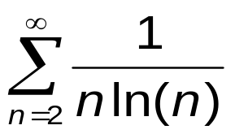
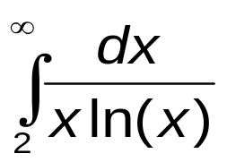
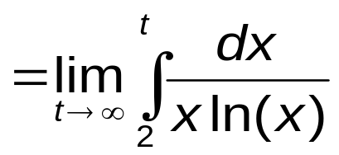
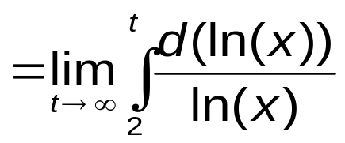
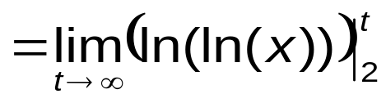
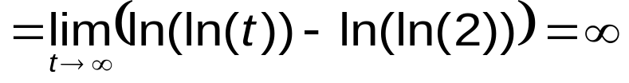
5.3 The Divergence and Integral Tests
Example
Determine whether the series converges or diverges.
Let f(x)=(xln(x))^{–1} . Then f(x) is continuous, positive and decreasing on [2, ∞).
→ The given series is divergent.

Slide 27

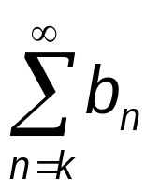
5.4 Comparison test
Comparison Test
Suppose that and are non-negative series
Assume a_{n} ≤ b_{n} for all n ≥ k. Then,
If converges, then also converges.
if diverges, then diverges.

Slide 28
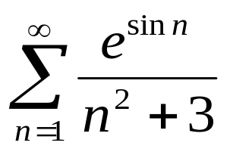
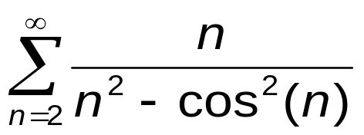
5.4 Comparison test
Example
Investigate the convergence of the series:
(a)
(b)

Slide 29

5.4 Comparison test

Slide 30




5.4 Comparison test
Example
Is the series convergent?
Compare the given series with
By Integral
Test
0 <c = 1, finite and converge →
converges

Slide 31


5.4 Comparison test
Example
Investigate the convergence of the series
(a)
(b)

Slide 32




5.5 Alternating series
Definition
The series is called an alternating series if its terms are
alternately positive and negative, that is,
a_{n} = (–1)^{n}b_{n} or a_{n} = (–1)^{n+1}b_{n} with b_{n} ≥ 0.
Examples:

Slide 33

5.5 Alternating series

Slide 34


5.5 Alternating series
Example
The series
is convergent.
Example
Is the series convergent?

Slide 35



5.5 Alternating Series
Theorem
If the series converges, then the series also
converges and we say that it converges absolutely.
Definition
A series is called conditionally convergent if it
is convergent but not absolutely convergent

Slide 36






5.5 Alternating Series
Example
Is convergent?
  The series converges. By the Comparison
  Test , the series converges. Hence,
  the series converges absolutely and so
  it converges.

Slide 37

5.5 Alternating Series
Example
Show that the series is conditionally convergent.

Slide 38


5.6 Ratio and Root test
The Ratio Test (D’Alembert)
Given a series . Let
Then,
If L < 1, then the given series converges absolutely (hence, converges).
If L > 1, then the series is divergent.
If L = 1, the Ratio Test is inconclusive; that is, no conclusion can be drawn. We have to use other tests (e.g., integral, comparison, alternating series Tests) .

Slide 39



5.6 Ratio and Root test
Example
Is convergent?
L > 1 → the given series is divergent.

Slide 40


5.6 Ratio and Root test
Example
Investigate the convergence of the series:
(a)
(b)

Slide 41

5.6 Ratio and Root test
The Root Test (Cauchy)
Given a series . Let
Then,
If L < 1 then the given series converges absolutely (hence, converges).
If L > 1, then the given series diverges.
If L = 1, the Root Test is inconclusive; that is, no conclusion can be drawn. We have to use other tests (e.g.,the integral, comparison, alternating series Tests).

Slide 42



5.6 Ratio and Root test
Example
Is convergent?
L > 1 → the given series diverges.

Slide 43
Summary
Guidelines for convergent/divergent testing.
If lim_{n→∞}a_{n}≠0 the series ∑ a_{n} diverges.
If a_{n} is of the form 1/n^{p} or x^{n}, use the property of these special series.
If a_{n} is a rational fraction or roots of polynomials, use the comparison/limit comparison Test.
If in the expression of a_{n} has ! or x^{n} , use the Ratio Test.
If a_{n} = (b_{n})^{n}, use the Root Test or Ratio Test.
If a_{n} is alternating, use the alternating series test.
If a_{n} = f(n) is positive and decreasing, use the Integral Test.

Slide 44
Summary
We have studied:
  Sequences
  Series
  Convergence Tests

